Slide 1

IMPROVING HEALTH DATA DECENTRALIZATION, INTEROPERABILITY AND PROVENANCE: A PROOF OF CONCEPT USING AMAZON MANAGED BLOCKCHAIN
ORINA TOLULOPE O.
Supervised by Prof. Ashley Akbari
Health Data Science, Faculty of Health Data Science, Swansea University

Slide 2
AGENDA
Research questions
Key Objectives
Background
Literature Review
Methodology
Results
Discussion
Conclusion
Future Research
Acknowledgements
References

Slide 3
RESEARCH QUESTIONS & OBJECTIVES
Questions
Objectives
What challenges exist in managing healthcare data?
How can we achieve inter-organizational collaboration in healthcare?
Are there existing options that tackle these challenges?
Which technologies can be leveraged to achieve greater control in the management of health data?
Empower patients to manage their health data securely.
Transform healthcare systems toward decentralization.
Improve data traceability and trust.
Enhance patient privacy.
Enable interoperability within healthcare through health data decentralization

Slide 4

BACKGROUND
Health data (what is health data?)
Decentralized vs Centralized systems
Challenges with health data management
Data decentralization in healthcare
Interoperability in Healthcare
Importance of lineage-tracing for health data
Blockchain – a decentralized ledger for health data
Applications of blockchain across the health sector

Slide 5
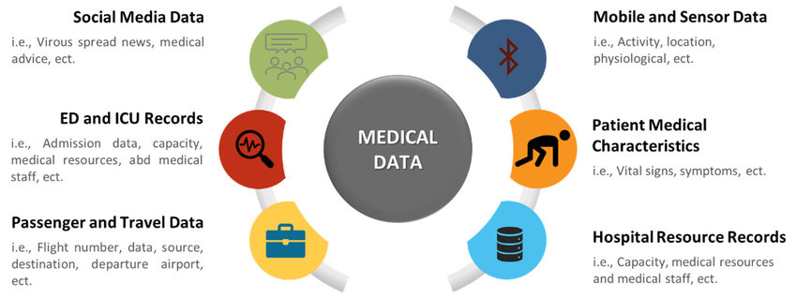
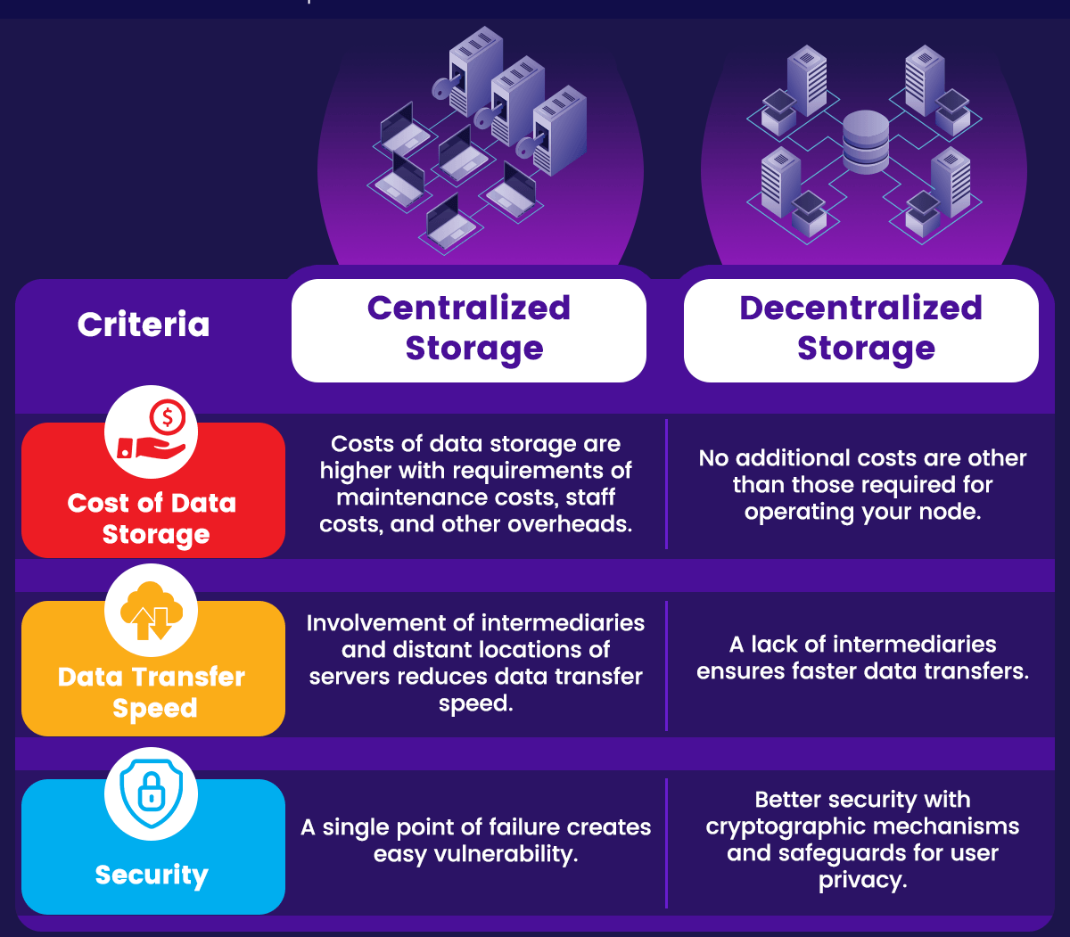
What is health data? - Data or information that relates to health - Patient data from healthcare providers - Travel data - Sensor data from devices - Medical Records - News feeds (about pandemics or endemics)
Centralized systems
A centralized data system is controlled by a single authority and might pose several challenges to interoperability, including lack of transparency, stale data, less redundancy, and vulnerability to attacks.
Decentralized systems
A decentralized data system is a type of system where each party manages their own information while still connecting to others and is said to be important to achieve genuine data fluidity, eliminating issues of trust by increasing transparency and data immutability

Slide 6
Current Challenges with health data management
Security: healthcare institutions often maintain centralized databases that contain sensitive patient information, from medical histories to genetic data. Such treasure troves become prime targets for cyberattacks. With medical records information being more expensive on the black market than credit card details.
Privacy and patient advocacy. patients frequently voice concerns about who has access to their medical records.
Interoperability: quality healthcare delivery requires the input of a multidisciplinary team from different branches within the healthcare system, from doctors to pharmacists to lab. scientists, nurses as well as financial managers.
Dependence: critical cases in emergencies, where rapid access to accurate medical information can save lives

Slide 7
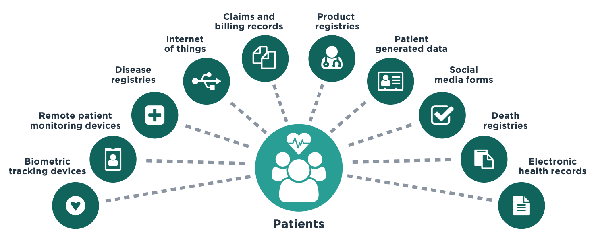
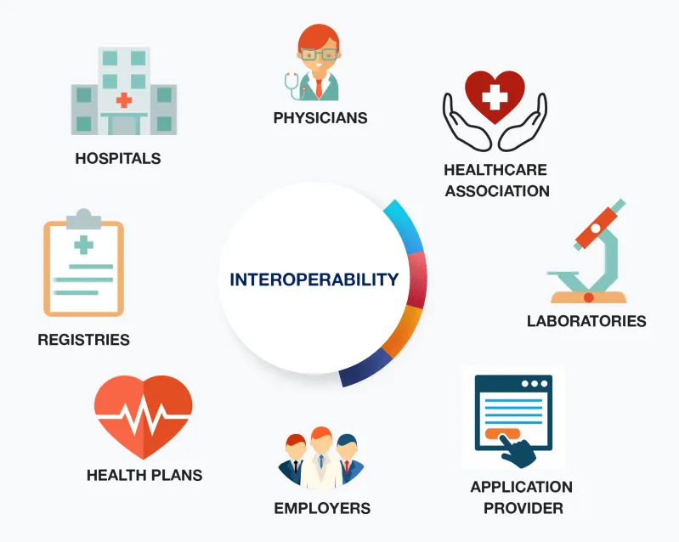
DATA DECENTRALIZATION IN HEALTHCARE
Siloed electronic health records (EHRs) limits support for the patient across transitions of care, longitudinal analyses and public health research.
A decentralized (and distributed) model helps with storage, information retrieval and access control as well as with efficient processing of health data.
To achieve interoperability within healthcare, standards that represents clinical data need to be set, having a reproducible, consistent format for identifying patients moved amongst different providers with the assurance of privacy being factored.
Interoperability in Healthcare
Ensuring interoperability of e-Health data can help facilitate improvements in general healthcare delivery.
Some use case requiring interoperability with regards to health data include; EHR laboratory results, emergency scenarios, medication management, bio-surveillance (in case of a disease outbreak) and others.

Slide 8
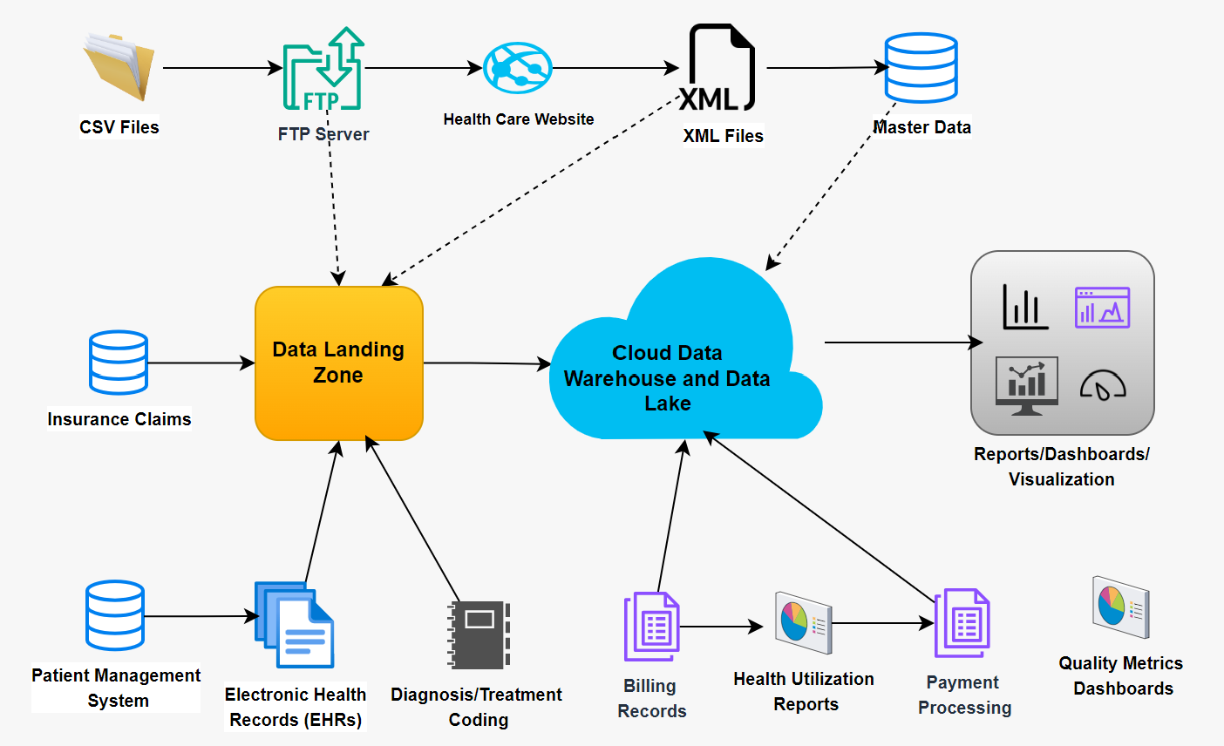
HEALTH DATA PROVENANCE (the importance of lineage-tracing for health data)
Data provenance is referred to as a documented trail that accounts for the origin of a piece of data and where it has moved from to where it is presently.
Data provenance is an important characteristic of health data systems that helps support the assessment of data quality by providing an audit-trail available at each process in time (tracking health information over its lifecycle).
It also helps with the continuous monitoring of various aspects of patients’ health as they go about their everyday activities for mobile health apps and devices.

Slide 9
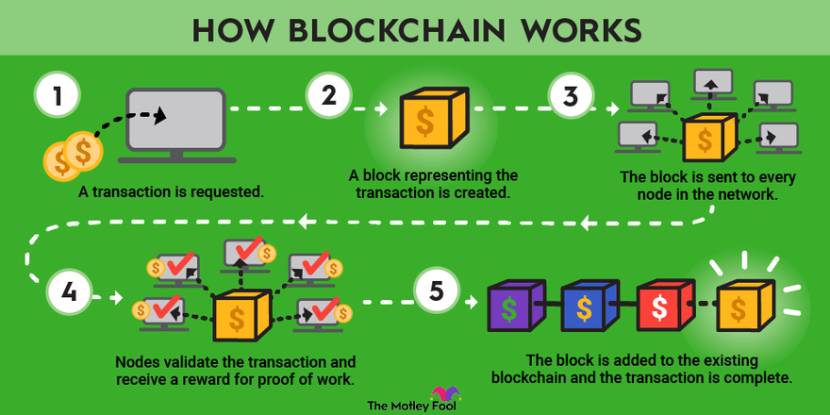
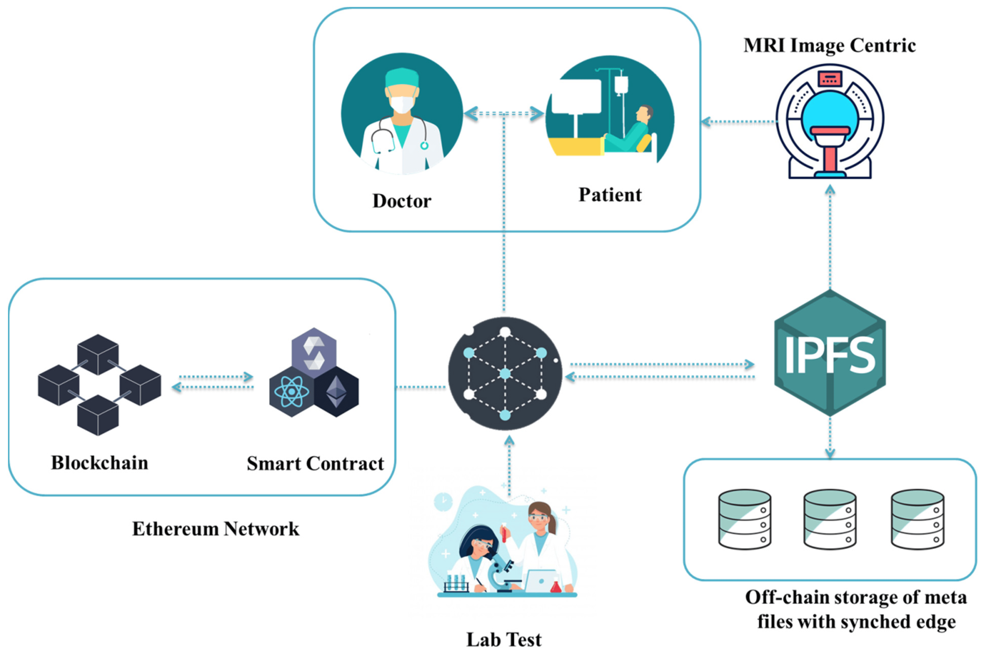
BLOCKCHAIN A decentralized ledger for health data.
Blockchain is an immutable ledger that stores data or metadata in a decentralized fashion.
The blockchain technology can be leveraged in healthcare to manage health data challenges such as security, privacy, trust, accessibility, and others.
Blockchain as a decentralized system improves interoperability within healthcare.

Slide 10
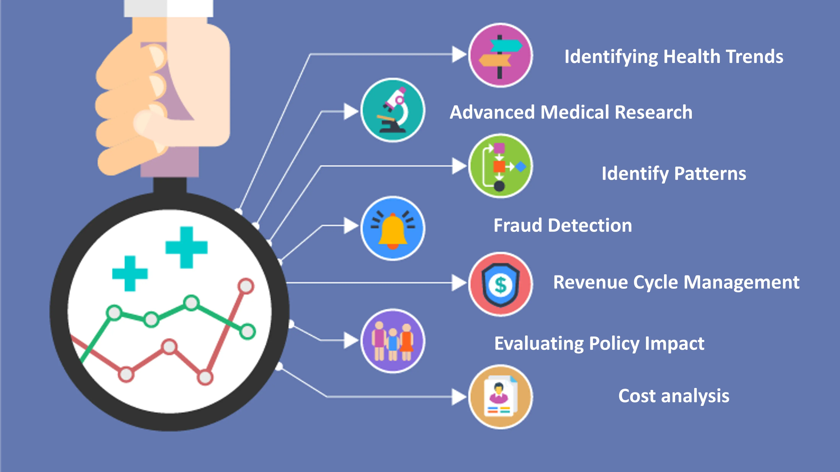
Applications of blockchain across the health sector
Population Health
Research Institutions and Pharmaceuticals
AI/ML in wearable devices
Insurance claims and Payments
Health Care Revenue
Public Health Policy

Slide 11
LITERATURE REVIEW
Existing research on health data management
Applications for decentralized health data
Current Implementations of blockchain in health data systems

Slide 12
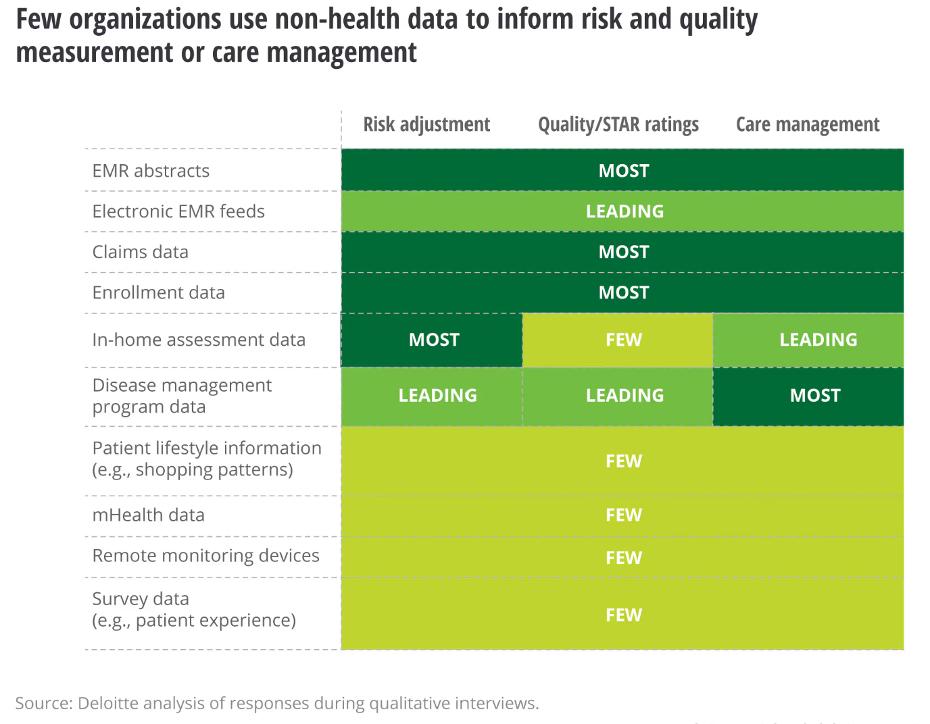
Survey by Deloitte
Most health organizations collect EMR abstracts, claims data, and data about enrolment and medical programs.
Only leading organizations use EMR feeds (updates) and device management program data.
Very few organizations use non-health data sources to augment formal medical data
35% of health organizations currently leverage the blockchain for their health data.

Slide 13
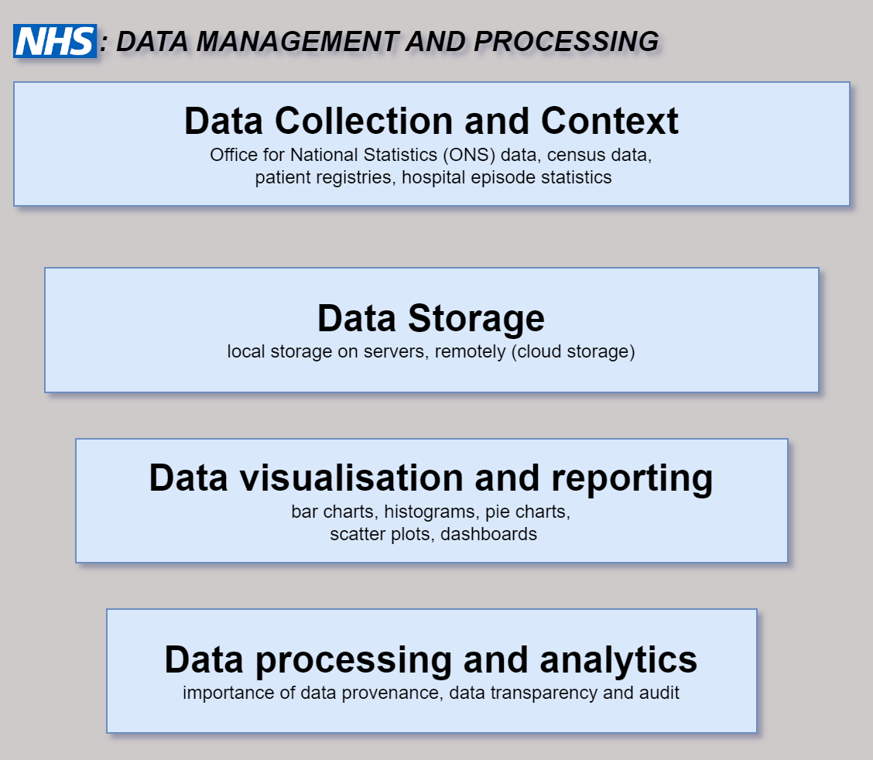
HEALTH DATA MANAGEMENT WITHIN NHS

Slide 14
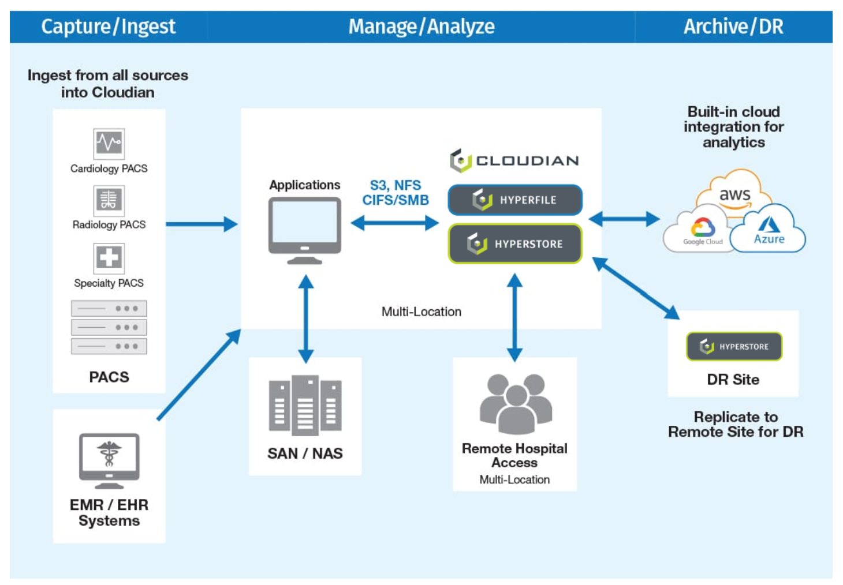
Cloudian
Provides HyperStore, an exabyte-scale, cost-effective storage platform for healthcare environments.
It allows healthcare organizations to store, move and protect files across locations at up to 70% lower cost than disk-based storage.
Challenges addressed by HyperStore include:
Fragmented data
Changes to data schema
Regulations and compliance

Slide 15
Applications for decentralized health data systems
Clinical trials: clinical trials subjects can have ownership of their own data, grant or revoke access to their data.
Audit trail (through its immutable nature) of patient clinical records used in these trails can be tracked to prevent falsification or tampering thereby meeting clinical trial standards and regulations.
Medicine supply chain management, where decentralization with blockchain technology almost guarantees full transparency in the shipping process with the blockchain ledger having a record of the data at every point in the distribution chain.
Blockchain can help speed up transaction processing for healthcare insurance, limit fraud detection, provide data confidentiality, and reduce overall cost.

Slide 16
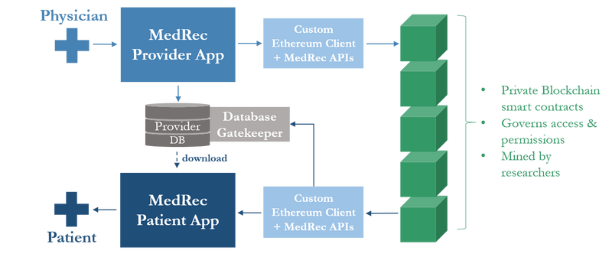
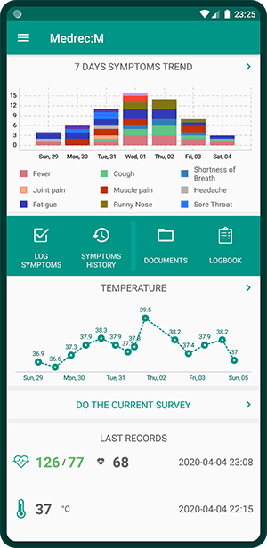
MedRec with a free mobile app to manage health data
A novel, decentralized record management system to handle EHRs (Electronic Health Records), using blockchain technology.
The system design gives patients a comprehensive, immutable log and access to their medical information across providers and treatment sites.
Leveraging unique blockchain properties, MedRec manages authentication, data retrieval, update track- ing for existing records, data entry (both for patients and providers) and data sharing.

Slide 17
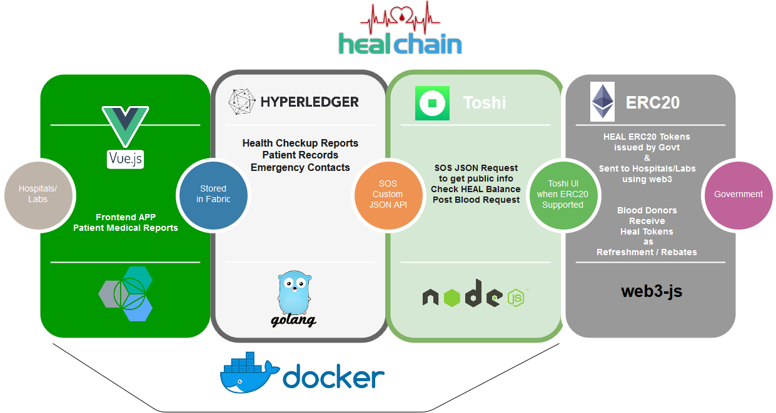
HealChain

Slide 18
METHODOLOGY
Amazon Managed Blockchain
Proof-of-Concept (PoC) of Blockchain-backed Health data (RxVault)
Architecture of RxVault
Modules and Functionalities

Slide 19
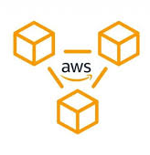
Amazon Managed Blockchain (AMB)
Fully managed service designed to help you build resilient Web3 applications on both public and private blockchains. Use AMB Access for instant and serverless access to multiple blockchains.
AMB helps with the undifferentiated heavy-lifting when deploying a specialized blockchain infrastructure and keeping them connected to the blockchain network.
Retrieve users’ historical token balances with standardized APIs to verify event ticket non-fungible tokens (NFTs).
Amazon Managed Blockchain currently supports Ethereum, Polygon, Bitcoin and Hyperledger Fabric blockchains.

Slide 20

Proof-of-Concept (PoC) Blockchain-backed Health data (RxVault)
In this paper, I aim to;
Develop an Hyperledger fabric implementation of a blockchain-based health data system, called RxVault, that provides a patient-centric approach to interoperability by leveraging the Amazon Web Services (AWS) cloud managed service, Amazon Managed Blockchain (using a managed service to solve issues with scalability, implementation and availability).
Build an interactive interface for users (patients and providers alike to interact securely and transparently).
Display insights from patient data to both patients and providers with patient data securely stored off-chain.

Slide 21
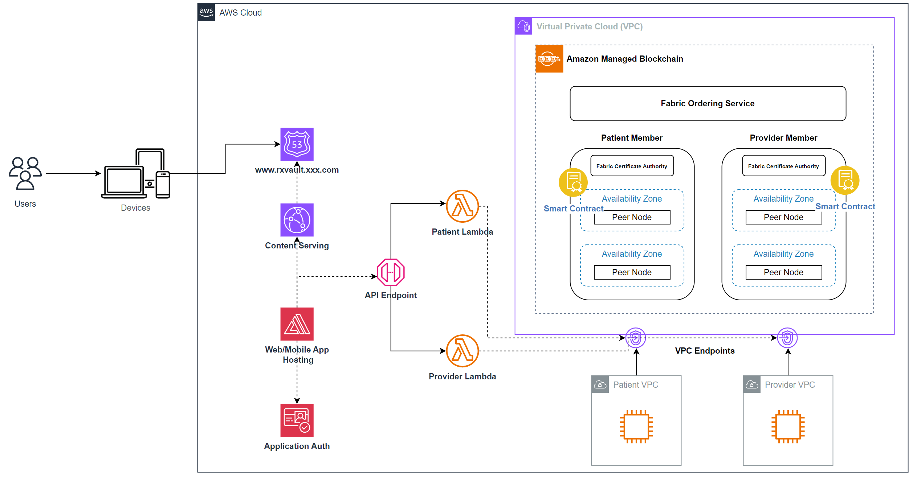
Architecture of RxVault

Slide 22
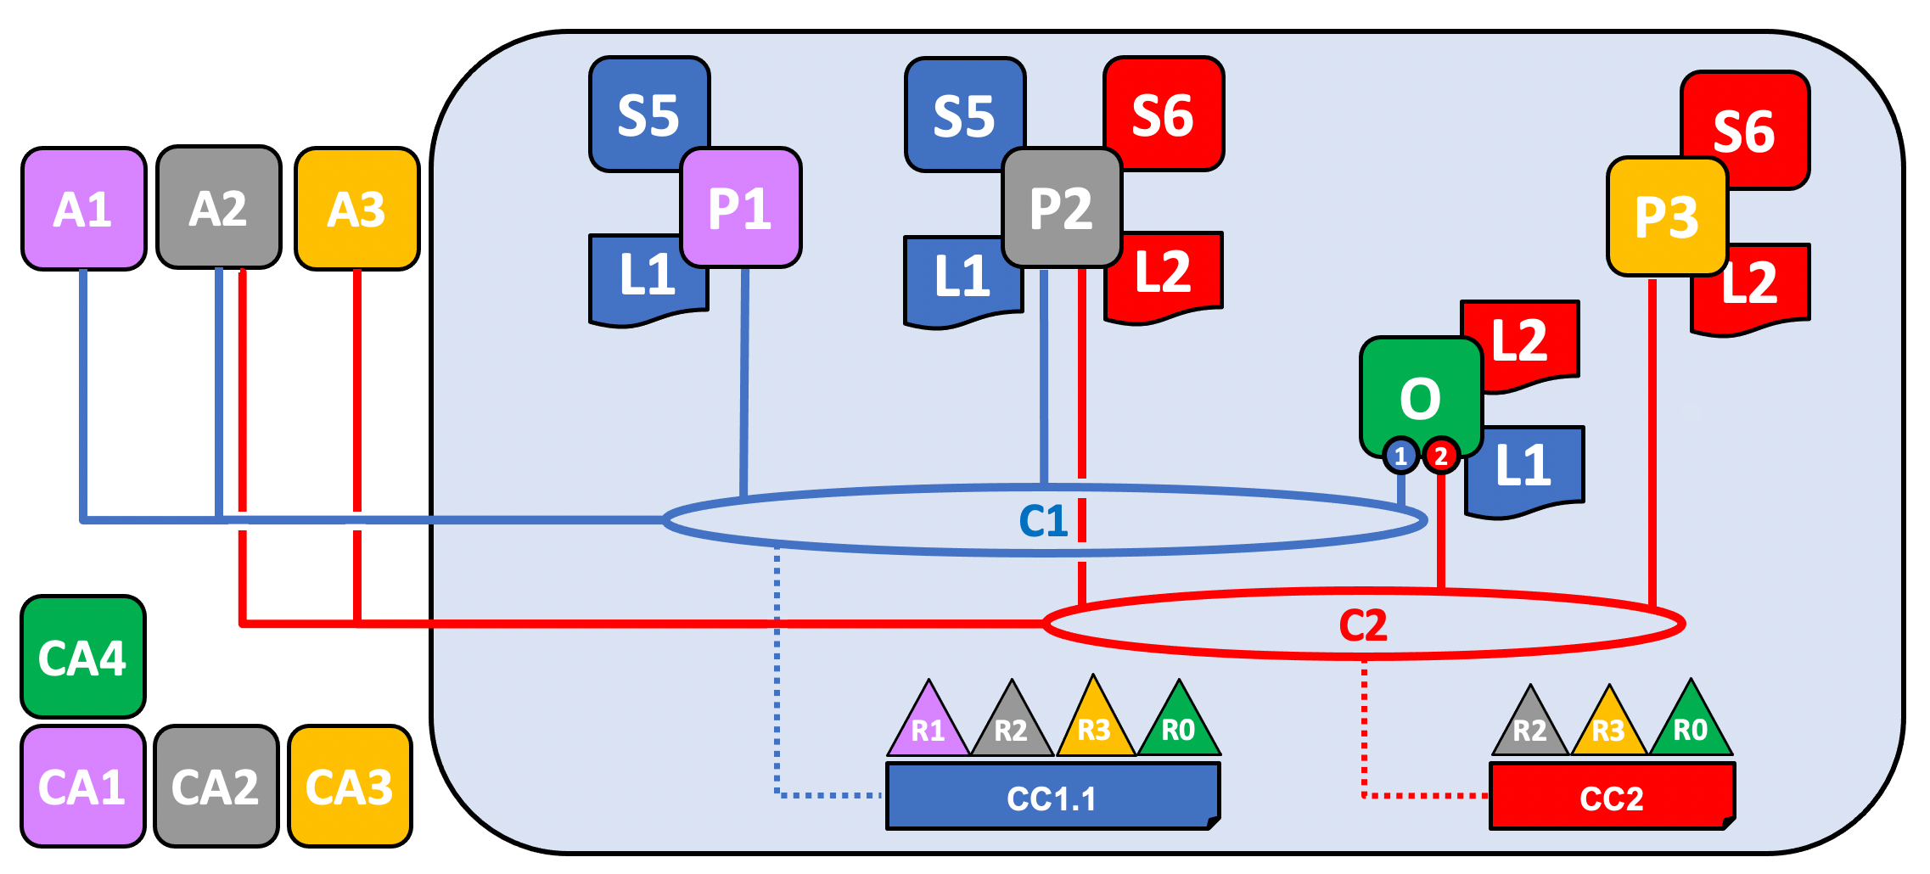
Modules and Functionalities
Fabric Ordering Service: a collection of one or more unbiased peers that adds endorsed transactions into a block.
Members (Patient, Provider): an organization or group of peers that represents an entity within a fabric network.
Peer Nodes: peers within an organization each with its own copy of the blockchain ledger (each peer has a certificate authority used to sign transactions).
Fabric Network: represents the fabric blockchain consisting of peers and organizations with other fabric constructs.
Backend Logic: delivers api requests through the fabric network.
Frontend: User Interface for interacting with the blockchain.

Slide 23

RESULTS
Rxvault Demo
Dataset Description and data preparation
Data analytics over the blockchain
Key Findings (graphs, tables, etc.)

Slide 24
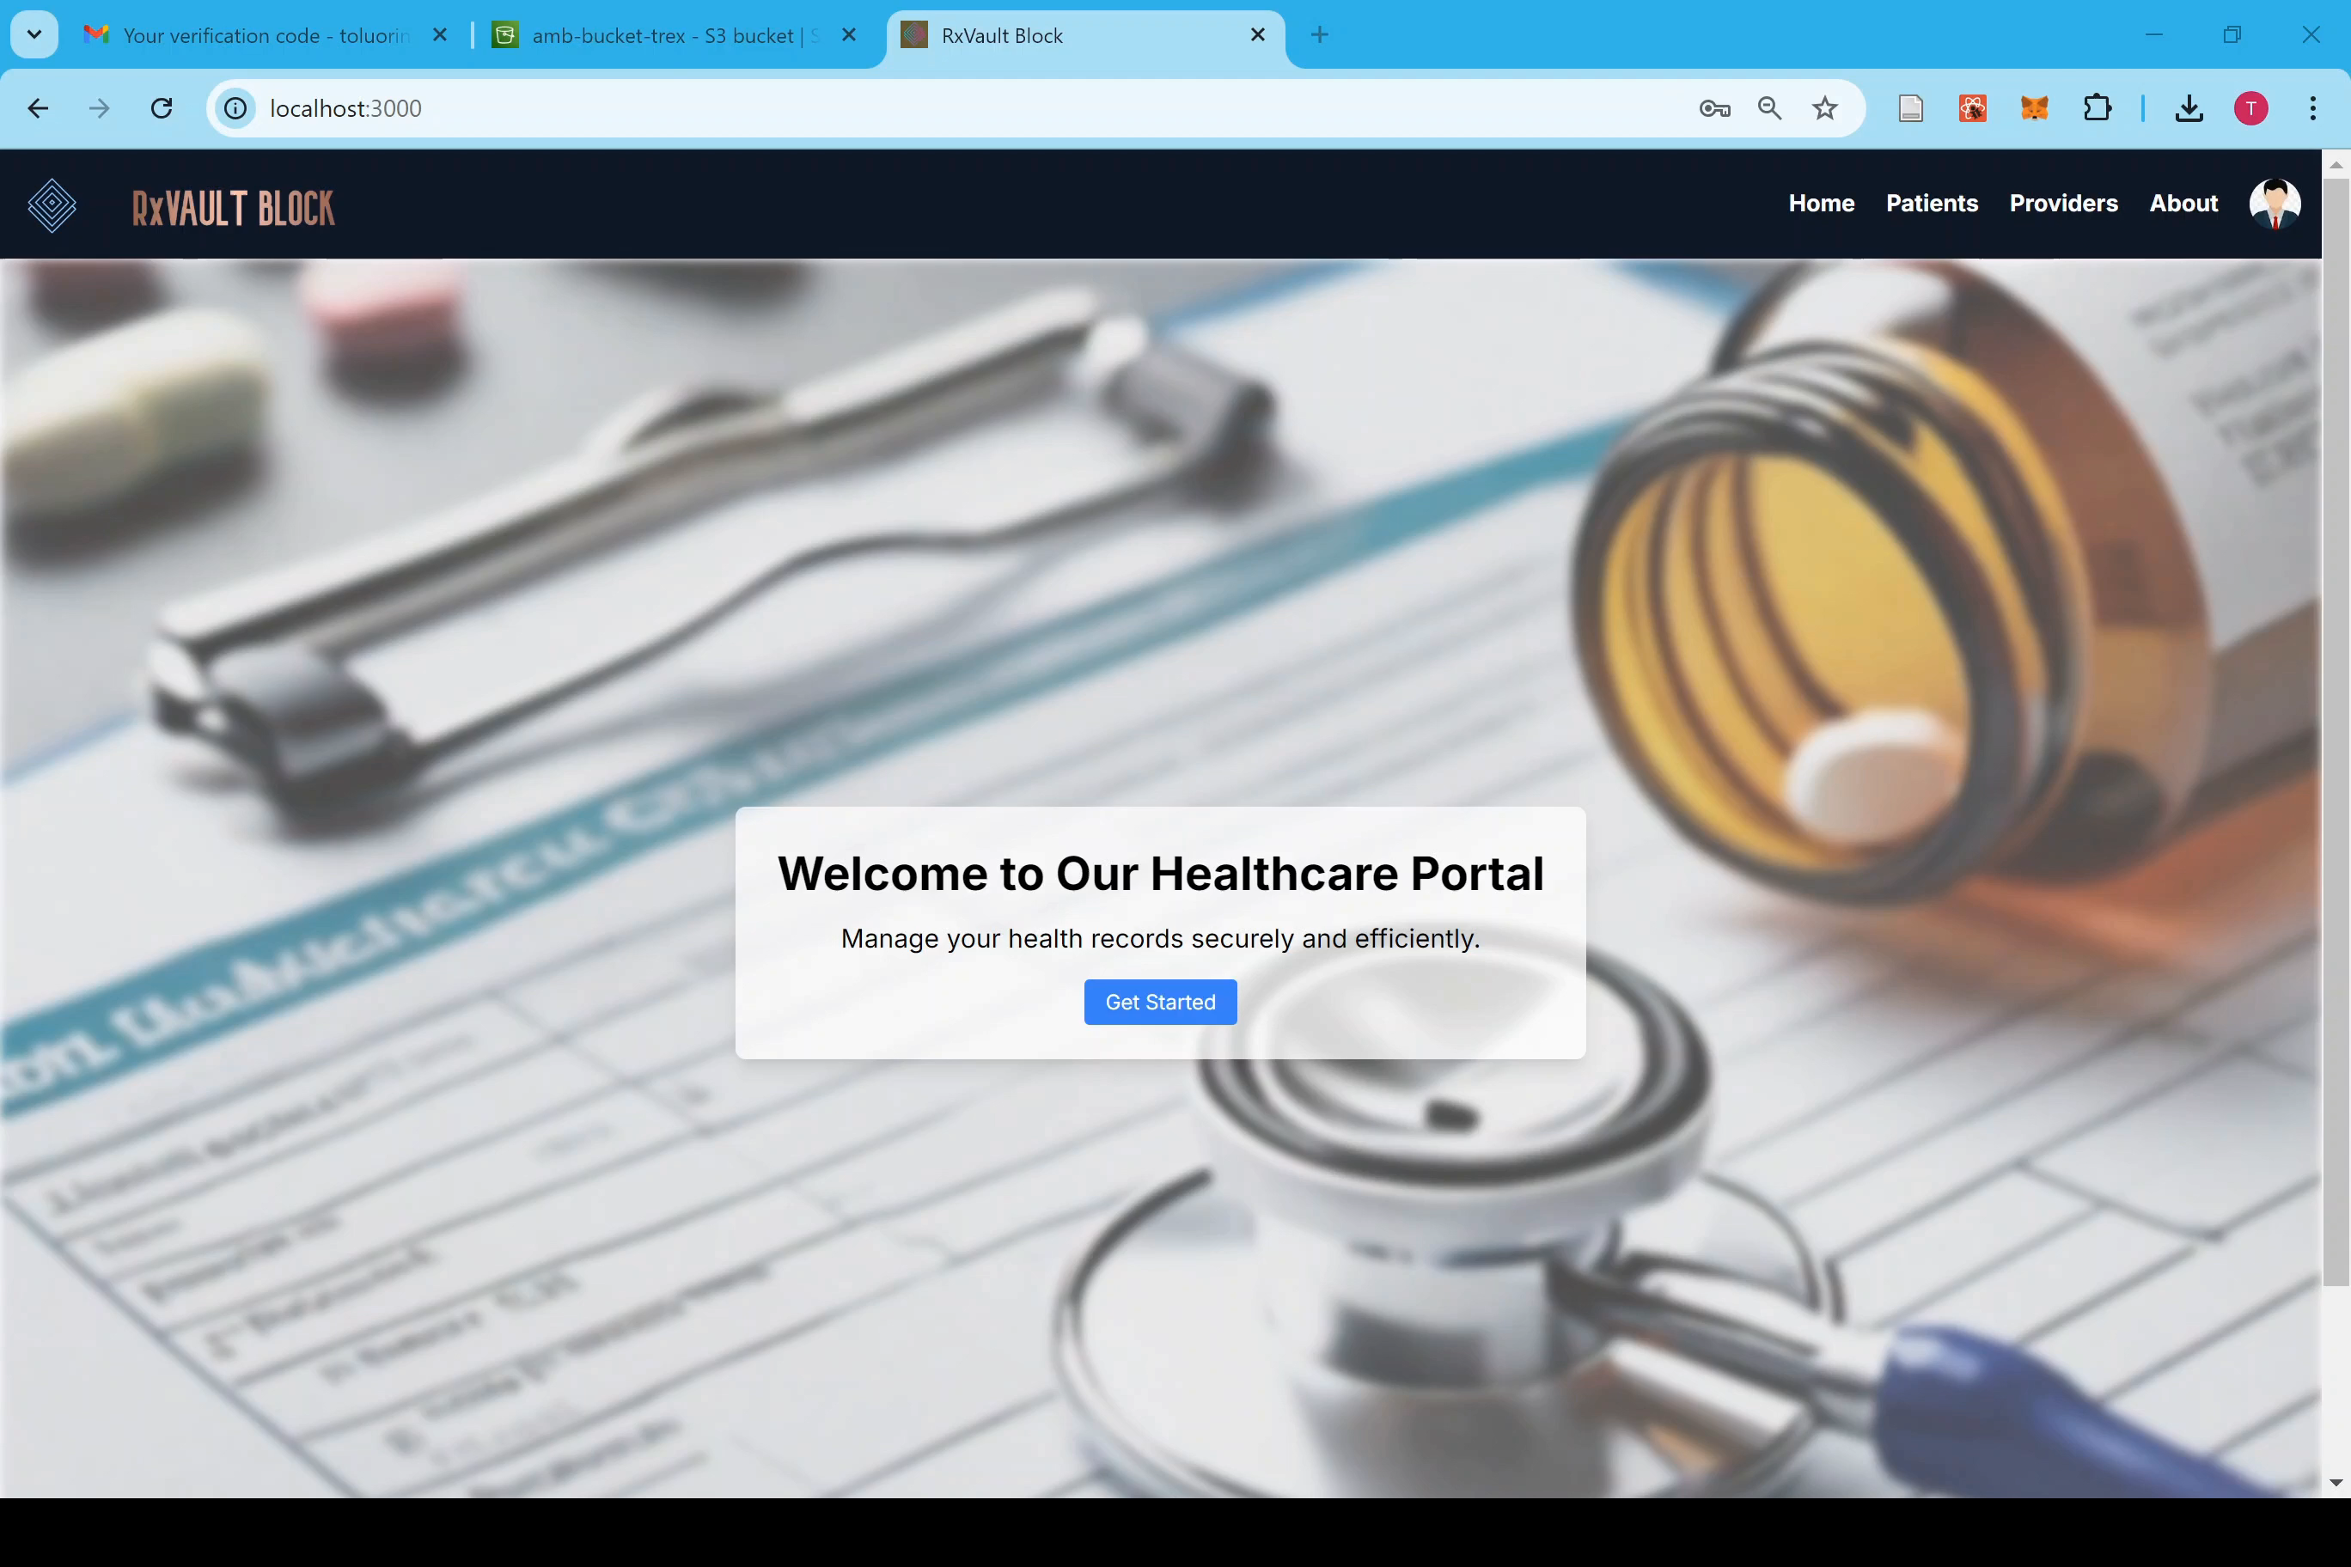
RxVault Demo

Slide 25

Dataset Description and data preparation
Dataset Description: The MIMIC-IV Clinical Database Demo was accessed from S3, and files within the "hosp" folder were used for analysis. The data were downloaded and processed using modular R scripts for efficiency.
Data Cleaning: After downloading the CSV files, they were unzipped, and basic cleaning was performed (e.g., removing missing values, filtering relevant data).

Slide 26
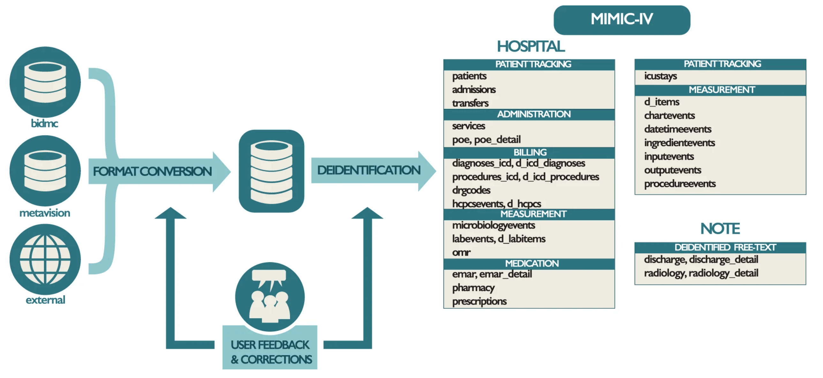

Slide 27
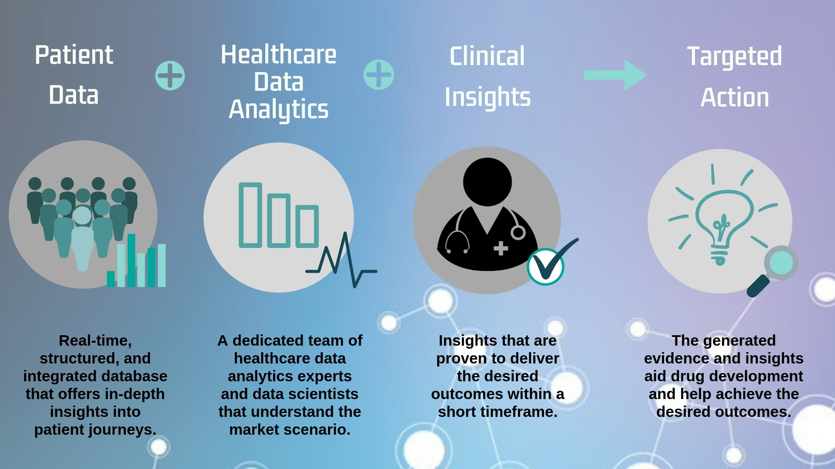
Health data analytics over the blockchain
Extensive analysis to derive actionable insights that aid informed patient care delivery

Slide 28
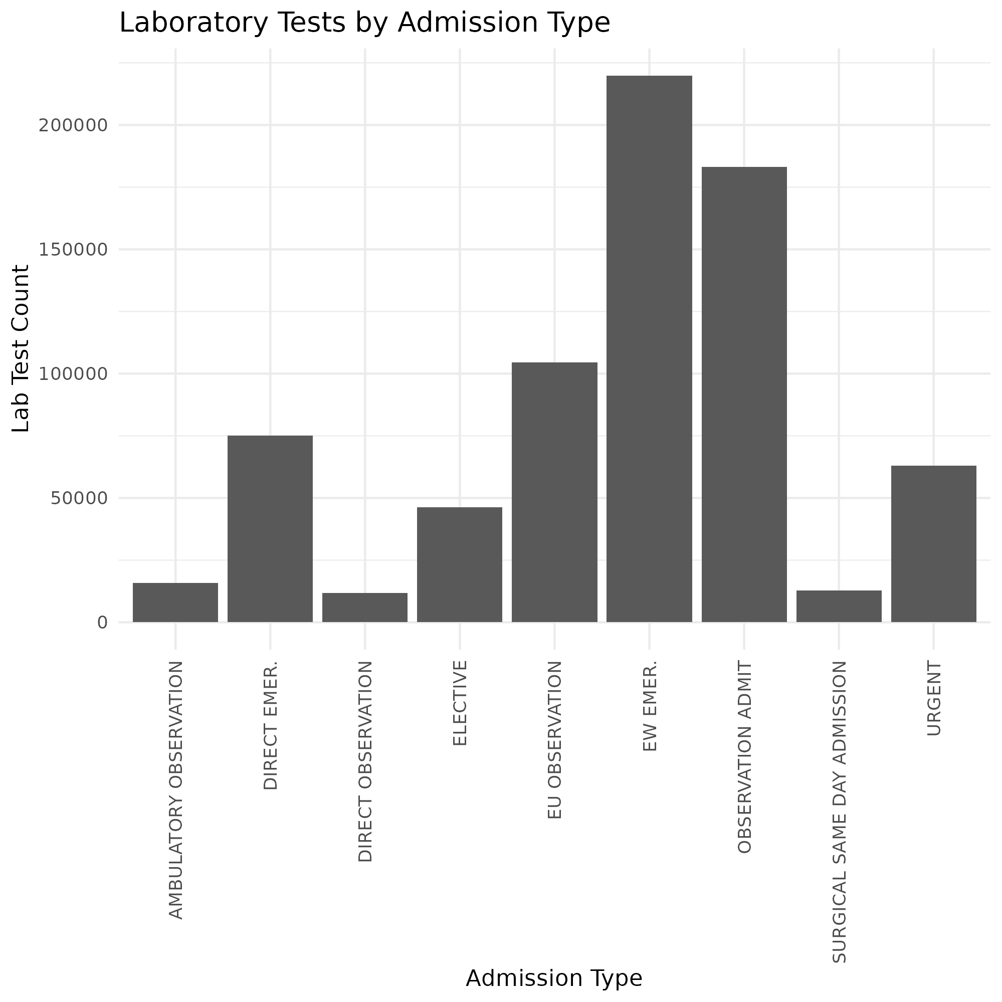
Laboratory tests by Admission type
Identify the frequency of lab test based on the nature of the admission

Slide 29
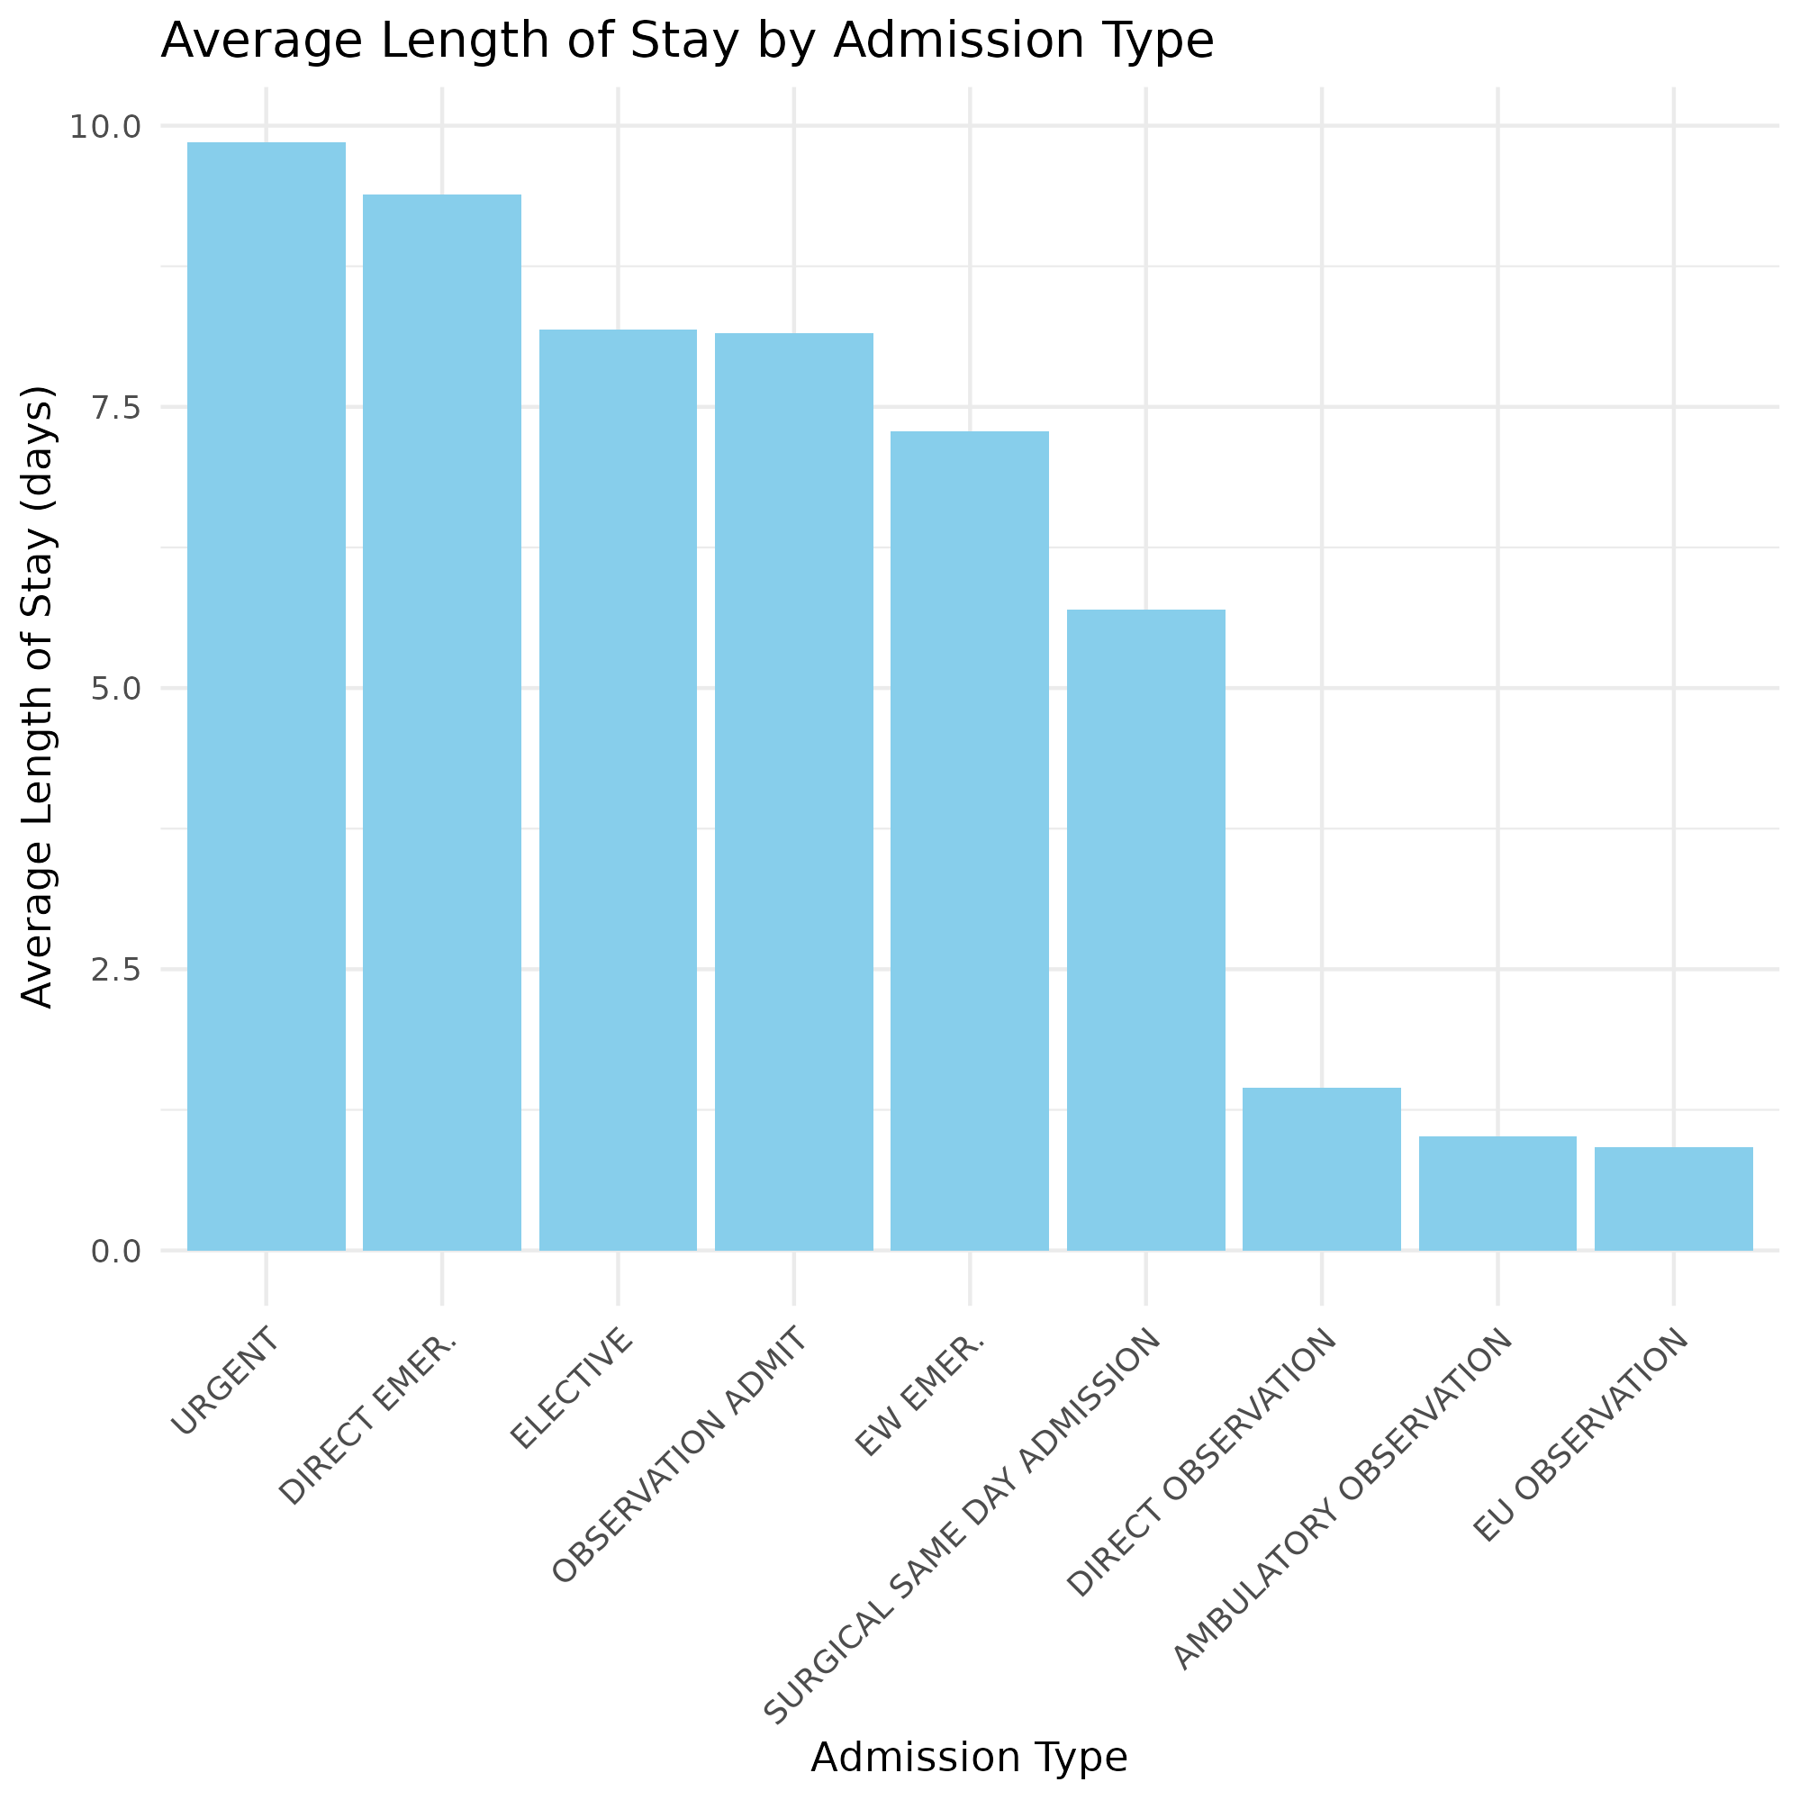
Length of Stay Analysis
We want to understand if there's a relationship between admission type and length of stay, which could help in resource allocation and patient flow management.

Slide 30
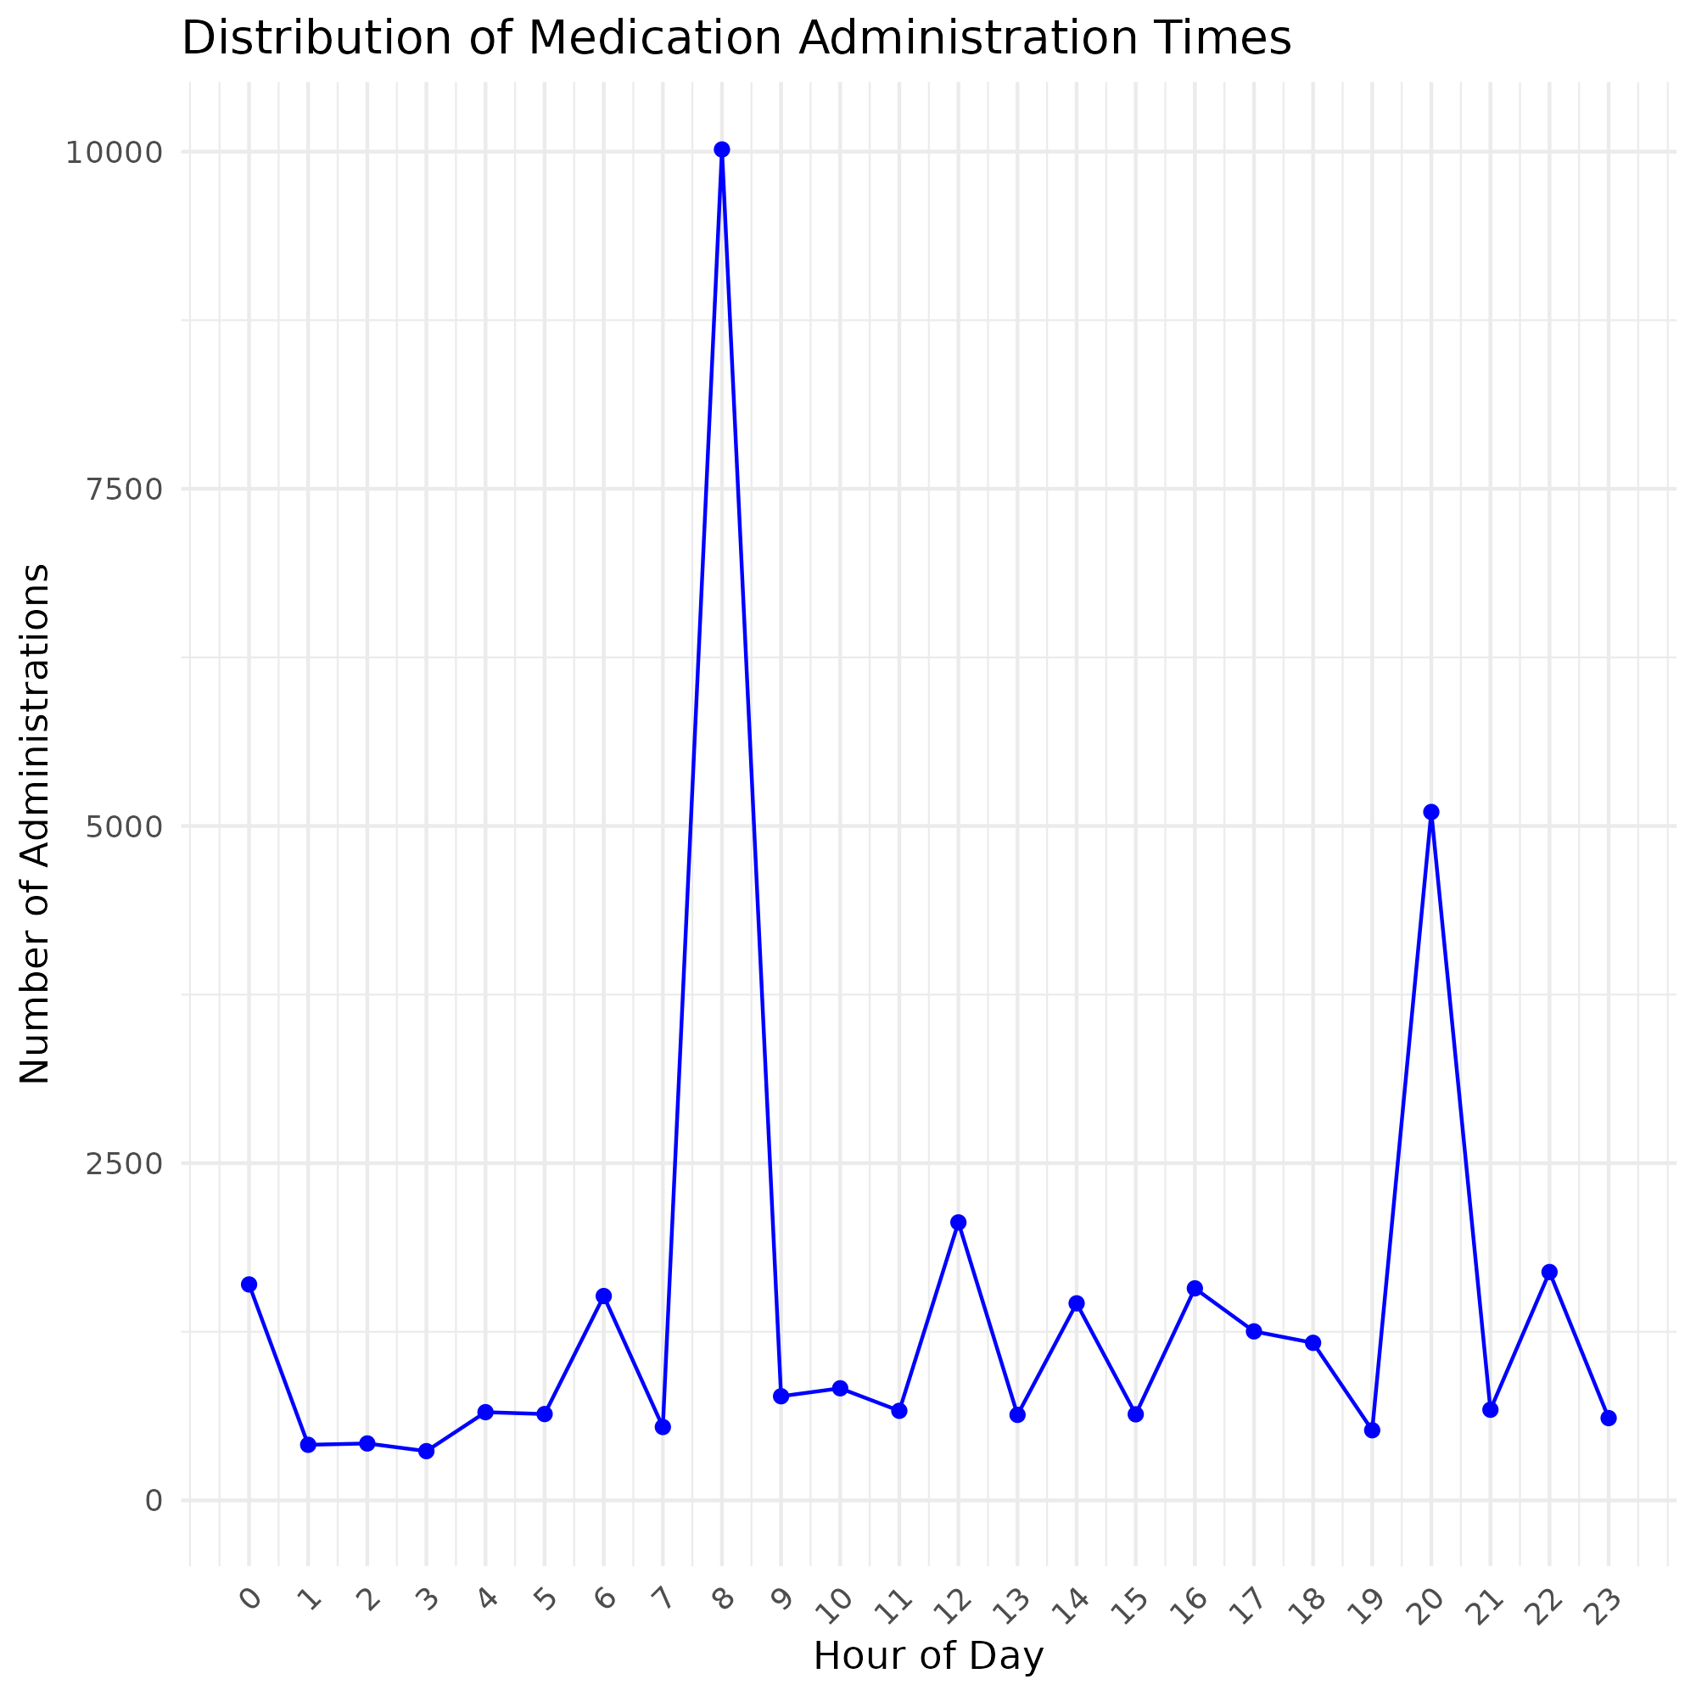
Medication Administration Time Analysis
The distribution of medication administration times throughout the day, which could help in staffing and workflow optimization.
Show the distribution of medication administration times across the 24 hours of the day, highlighting peak times and potential staffing needs.

Slide 31
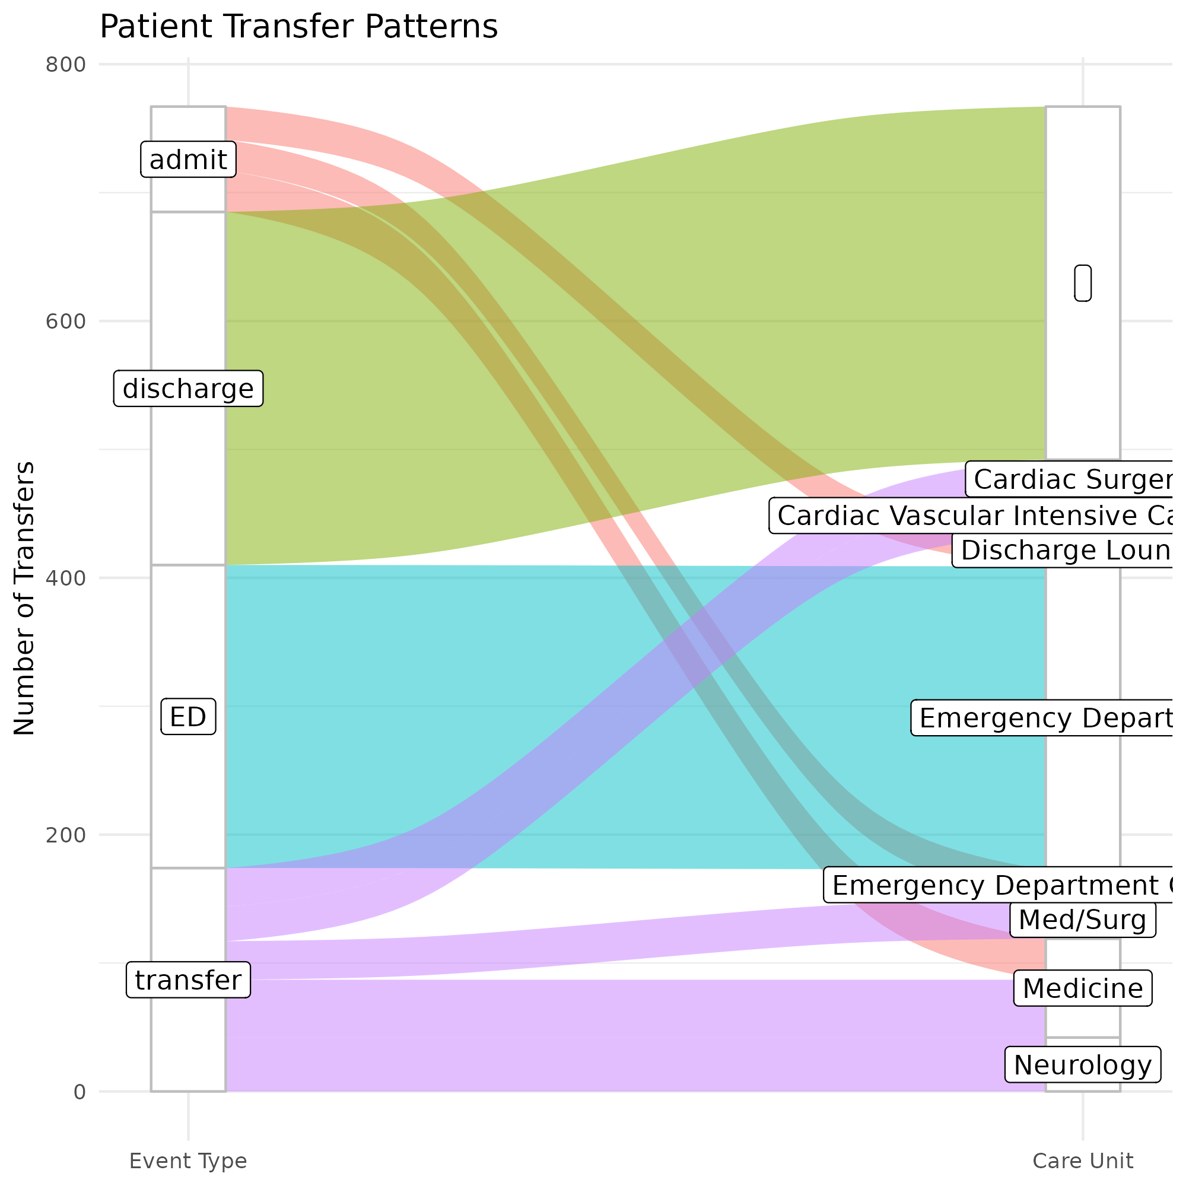
Patient Transfer Pattern Analysis
What are the most common patient transfer patterns within the hospital, which could help optimize bed management and patient flow?
Identify areas for improvement in resource allocation, staffing, and patient management.

Slide 32
DISCUSSION
I have proposed a patient centered blockchain-based healthcare platform, RxVault, that gives patients the ability to grant access and/or deny access to providers (doctors, researchers etc.).
I have also demonstrated performing healthcare analytics on an off-chain EMR data, MIMIC-IV to derive actionable insights that helps with informed decisions
The functionalities from the blockchain application shows the possibility of having secure, trustable interoperability at the patient-provider level.

Slide 33
CONCLUSION
By implementing a decentralized healthcare platform, we can achieve true transparency, security, data provenance amongst other desirable means of interoperability within healthcare.
It is important to note that the current implementation shows interoperability between patient and provider only. This can be extended to accommodate other operations between different providers or organizations for example.
Cost would need to be factored before making a more robust implementation. Additionally, funding might be needed to come up with a minimum viable product (MVP).
FURTHER WORK
Extend the current implementation to accommodate more organizations.
Carry out analysis on other featured data that meets with industry standard.
Research and implement use of non-fungible tokens(NFTs) for healthcare digital identity.

Slide 34
ACKNOWLEDGEMENTS
GOD ALMIGHTY
My Supervisor, Professor Ashley Akbari
Former HDS Director, Dr. Pete Arnold
Director, Prof. Micheal Gravenor
Current HDS Program Director Dr Vesna Vuksanovic

Slide 35

REFERENCES
Pros and Cons of Centralized and Decentralized Data Networks for Interoperability, 2023
https://cloudian.com/guides/hipaa-compliant-cloud-storage/health-data-management/
https://digital-transformation.hee.nhs.uk/building-a-digital-workforce/dart-ed/horizon-scanning/ai-and-digital-healthcare-technologies/framework-structure/health-data-management
https://hyperledger-fabric.readthedocs.io/en/release-2.5/network/network.html
https://www.healthdatamanagement.com/articles/why-theres-potential-to-use-decentralizing-identity-in-healthcare

Slide 36

THANK YOU
Questions

